Slide 1
Syracuse University School of Information Studies Master of Science Applied Data Science Portfolio Milestone
Himadri Tewari hstewari@syr.edu SUID – 227851541 https://github.com/hstewari

Slide 2
Introduction
The Masters in Applied Data Science program at Syracuse University helps the students to learn and implement the application of data science by providing the opportunities to collect data, analyze, do predictive analysis by applying machine learning and data mining techniques and create visualizations.
IST 652 – Scripting for Data Analysis
IST 736 – Text Mining
IST 707 – Data Analytics
IST 659 – Data Admin Concepts & Database Management

Slide 3

IST 652 – Scripting for Data Analysis
Analysis of New York City Current Job Postings

Slide 4
Introduction
The objective of the project is to analyze the current job posting data of New York City.
Data Set – The dataset is collected from the Kaggle which contains job posting available in the City of New York’s official job site.
Programming – Python, Jupyter Notebook

Slide 5
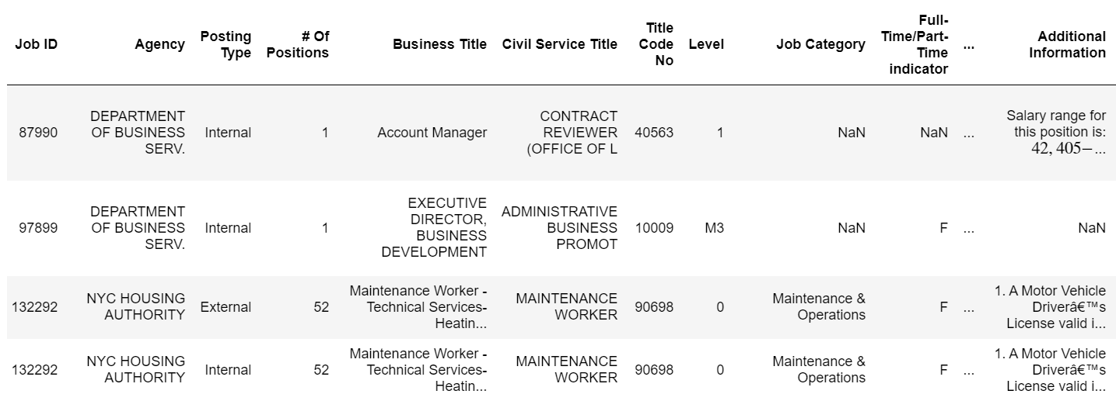
Data Analysis
Summary of the dataset

Slide 6
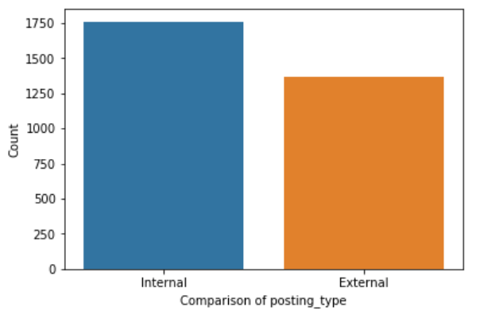
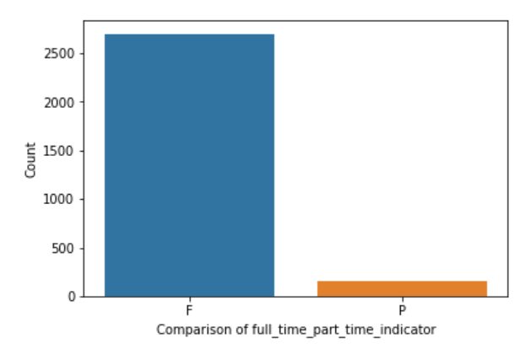
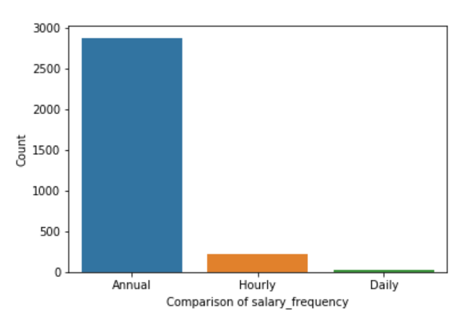
Data Analysis
As part of the data analysis process, data comparison was done for Posting Types, Full Time/Part-Time Indicator and Salary Frequency

Slide 7
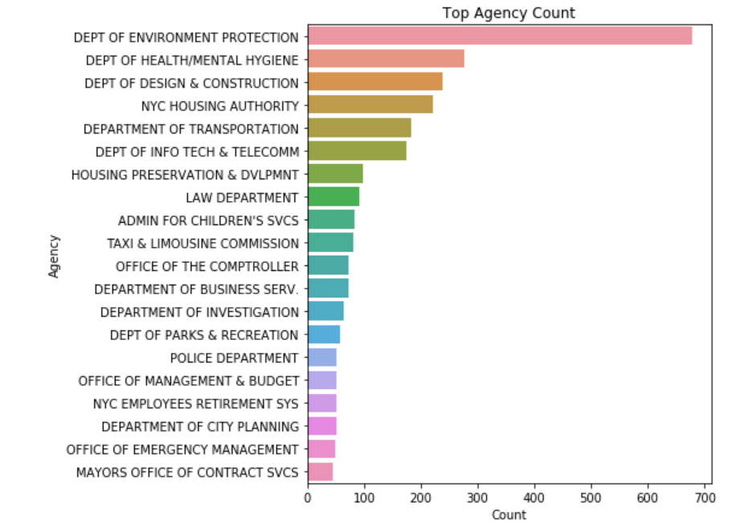
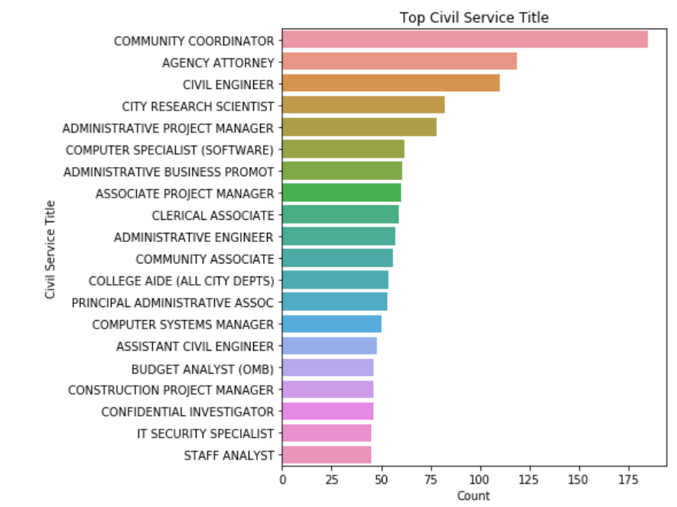
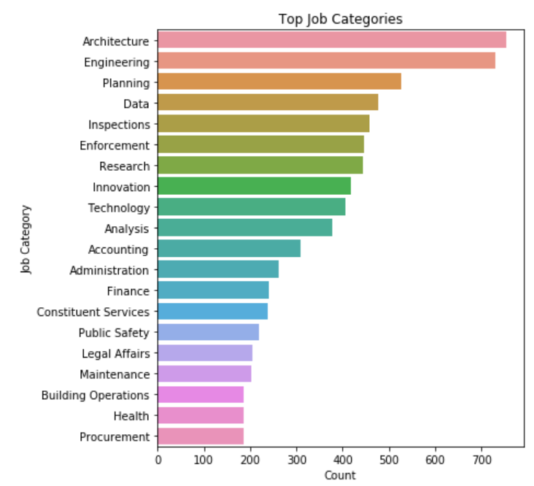
Data Analysis
The next analysis was done to find out the top counts of attributes like Agency, Civil Service Title and Job Categories.

Slide 8
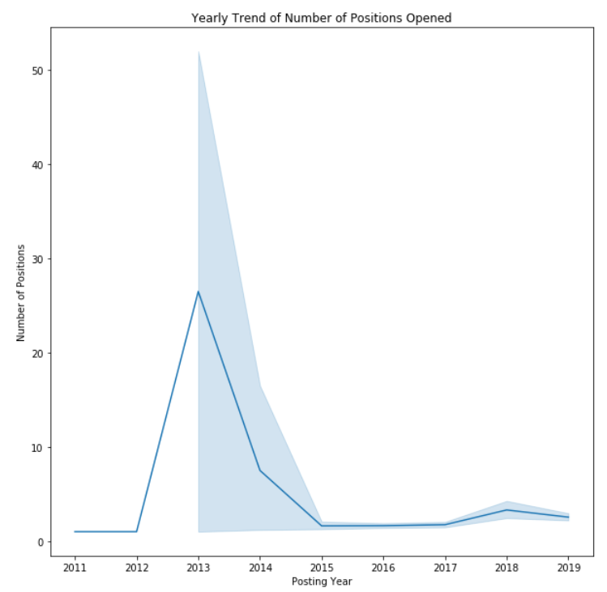
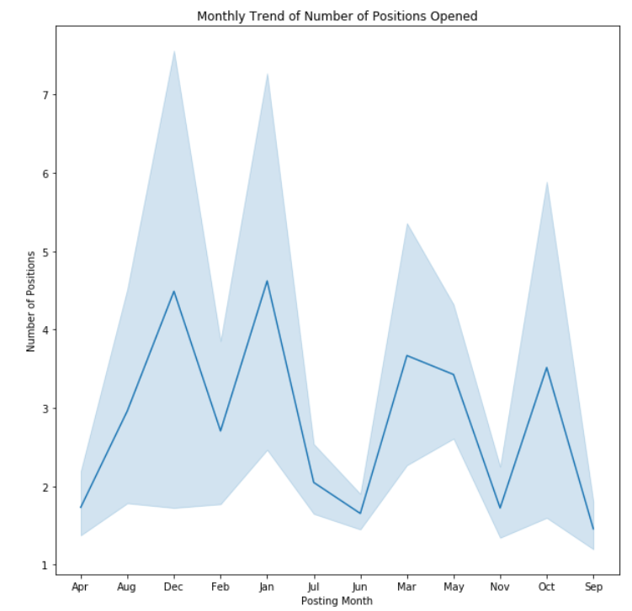
Data Analysis
Using the month and year column, yearly and monthly trend of the number of positions were visualized.

Slide 9
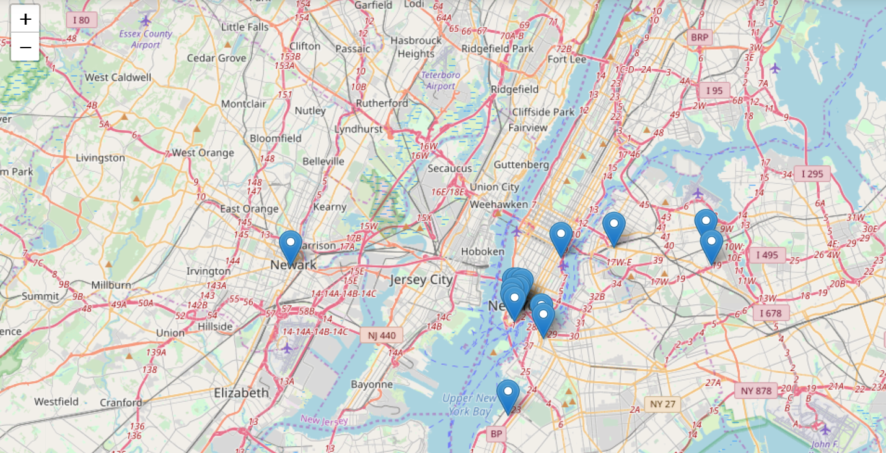
Map-Based Spatial Analysis
The agency’s work address was generated on the map.

Slide 10
Achievements
The project provided an opportunity to collect external data, converting it by cleaning, transforming and modeling with the objective of identifying useful information, suggesting collections and supporting decision making.
Identify the trends, hidden pattern, design charts, and visuals and help the organization to take correct strategic decision.
User privacy is taken care in the project. It does not contain any personal information

Slide 11
IST 736 – Text Mining
Analysis of Employee Reviews: Amazon, Apple, Facebook, Google, Microsoft and Netflix

Slide 12
Introduction
The goal of this project was to apply text mining techniques to employee reviews analysis.
Data Set – Over 67k employee reviews for Google, Amazon, Facebook, Apple, Netflix and Microsoft are collected from Kaggle dataset.
Programming – Python, Jupyter Notebook

Slide 13
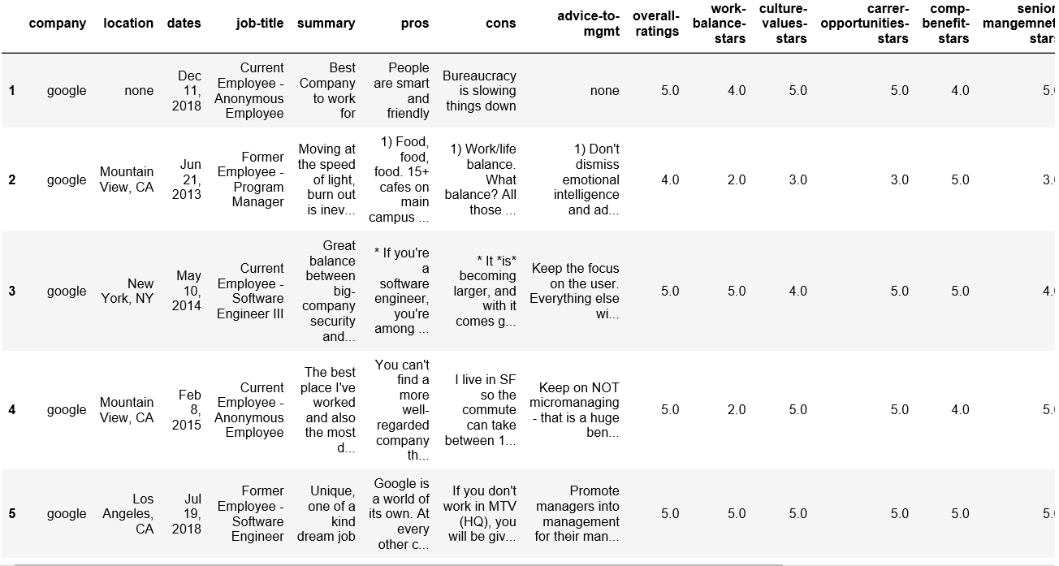
Data Analysis
Summary of the dataset

Slide 14
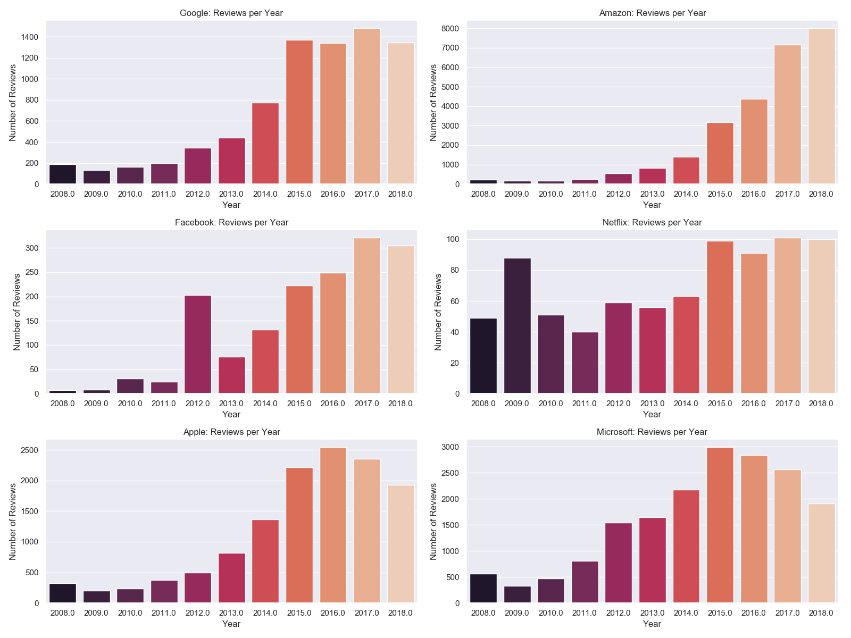
Data Analysis
As part of the data analysis process, review comments per year were compared for each of the company.

Slide 15
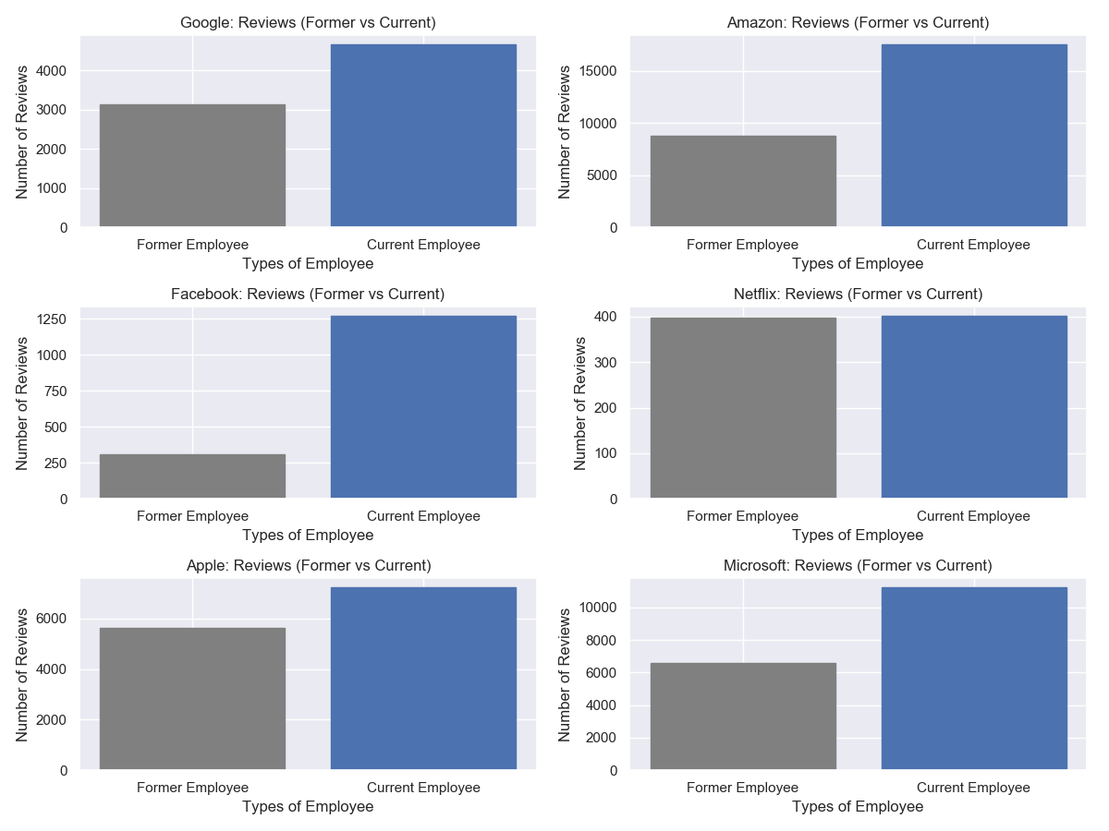
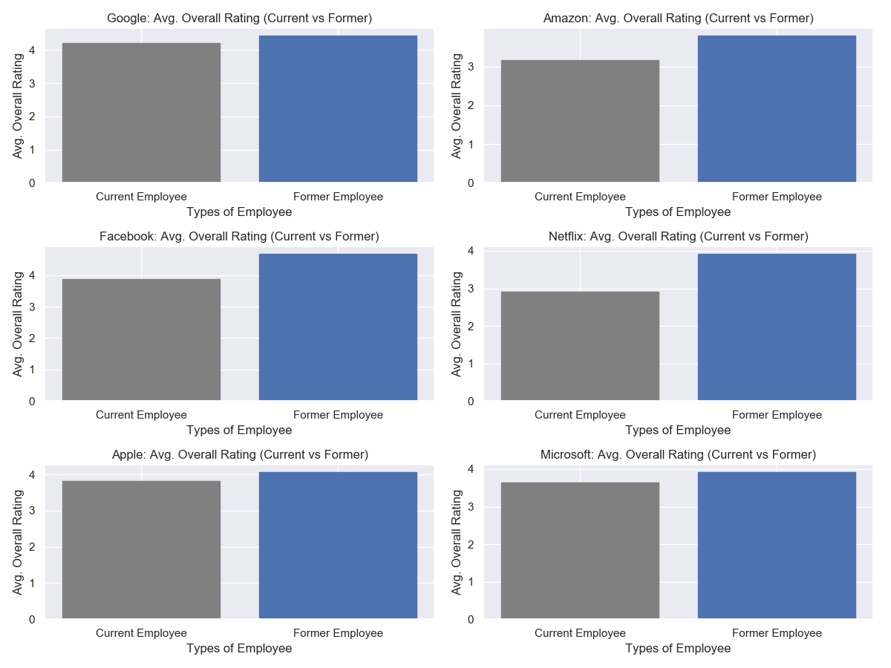
Data Analysis
The next analysis was done to find out the review count per employee type and overall rating per employee type.

Slide 16
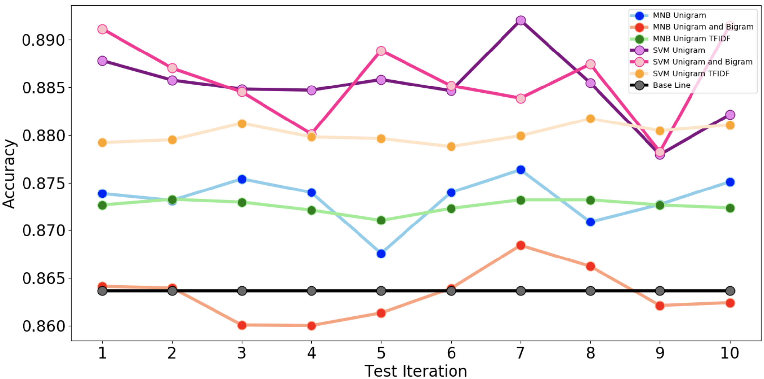
Methodology
Best - SVM with Uni & Bi Count vectorizer achieved 0.886 average accuracy over 10 folds cross-validation. SVM basically is better than MNB
Model\Vectorizer | Uni Count |  | Uni & Bi Count |  | Uni & Bi TFIDF
MNB | 0.873 | +/- 0.002 | 0.863 | +/- 0.003 | 0.873 | +/- 0.001
SVM | 0.885 | +/- 0.003 | 0.886 | +/- 0.004 | 0.880 | +/- 0.001

Slide 17
Achievements
The project provided an opportunity to collect external data, converting it by cleaning, transforming and modeling with the objective of identifying useful information, suggesting collections and supporting decision making.
Identify the trends, hidden pattern, design charts, and visuals and help the organization to take correct strategic decision.
The result indicates the importance of using different text mining and data mining techniques to develop accurate prediction models.
User privacy is taken care in the project. It does not contain any personal information

Slide 18
IST 707 – Data Analytics
Prediction of Readmission Rates in U.S Hospitals

Slide 19
Introduction
The objective of the project was to study the different factors that contribute to the readmission of patients.
The dataset was collected from the health facts database which represents 10 years of clinical care data. The dataset contains 50,000 rows.
Programming – R Studio

Slide 20
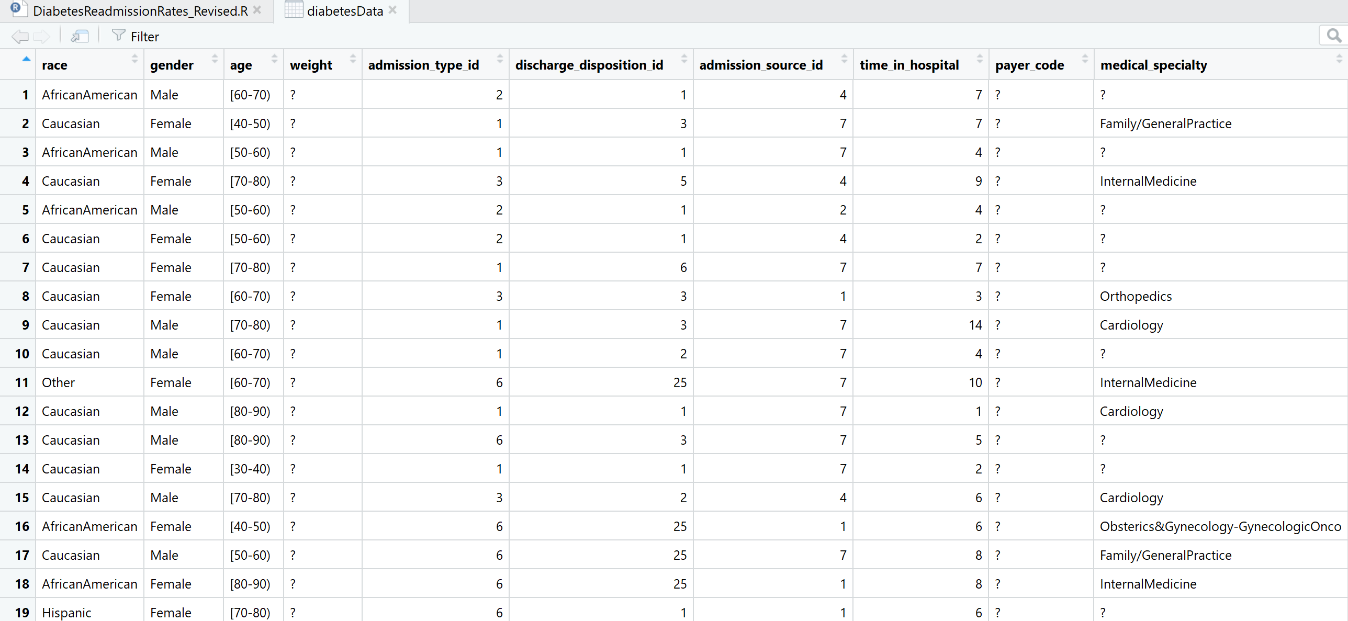
Data Analysis
Summary of the data set

Slide 21
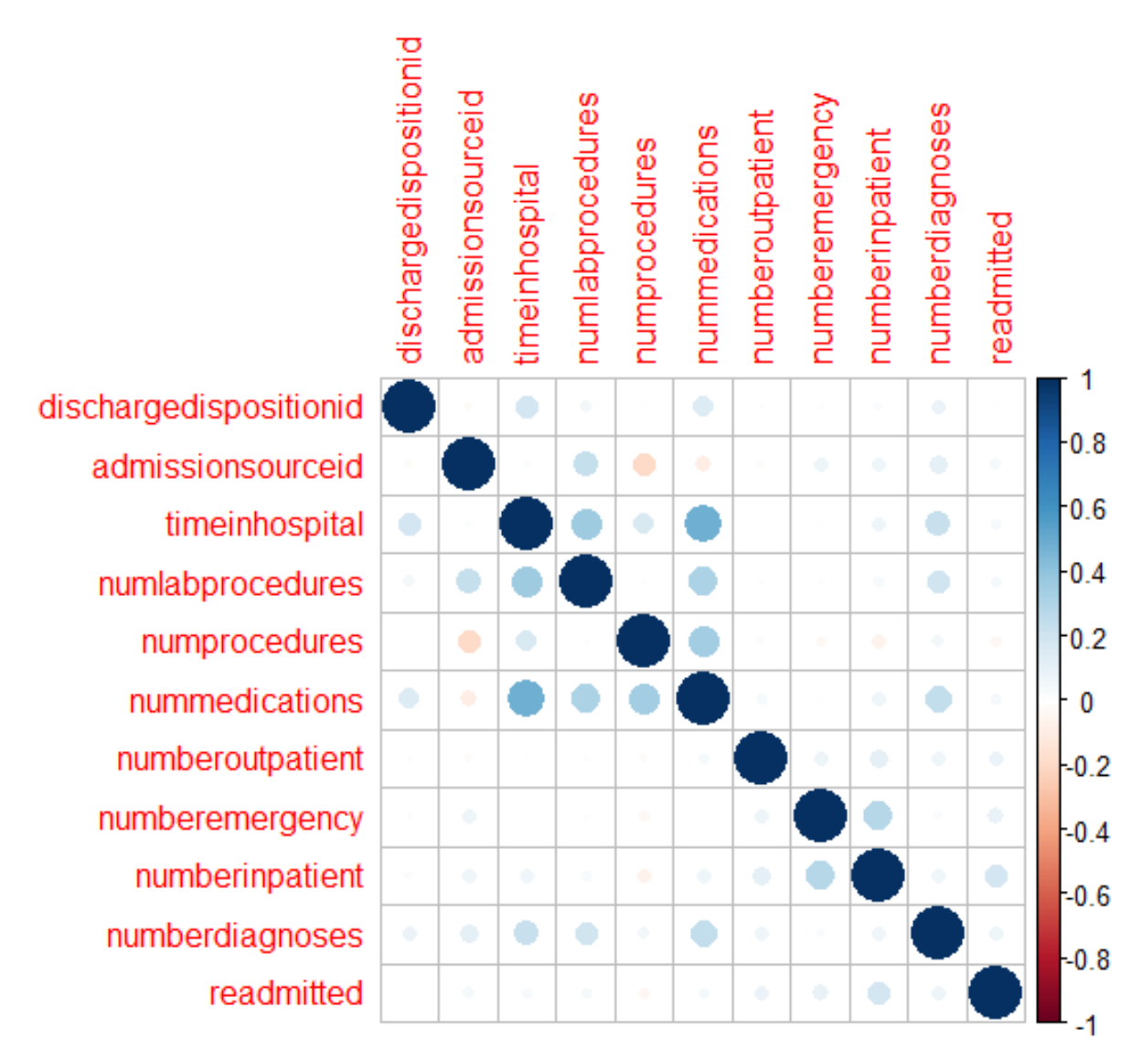
Correlation Matrix
A correlation matrix was visualized to understand the correlations between integer variables and possibly eliminate one of the pairs with high correlations.

Slide 22
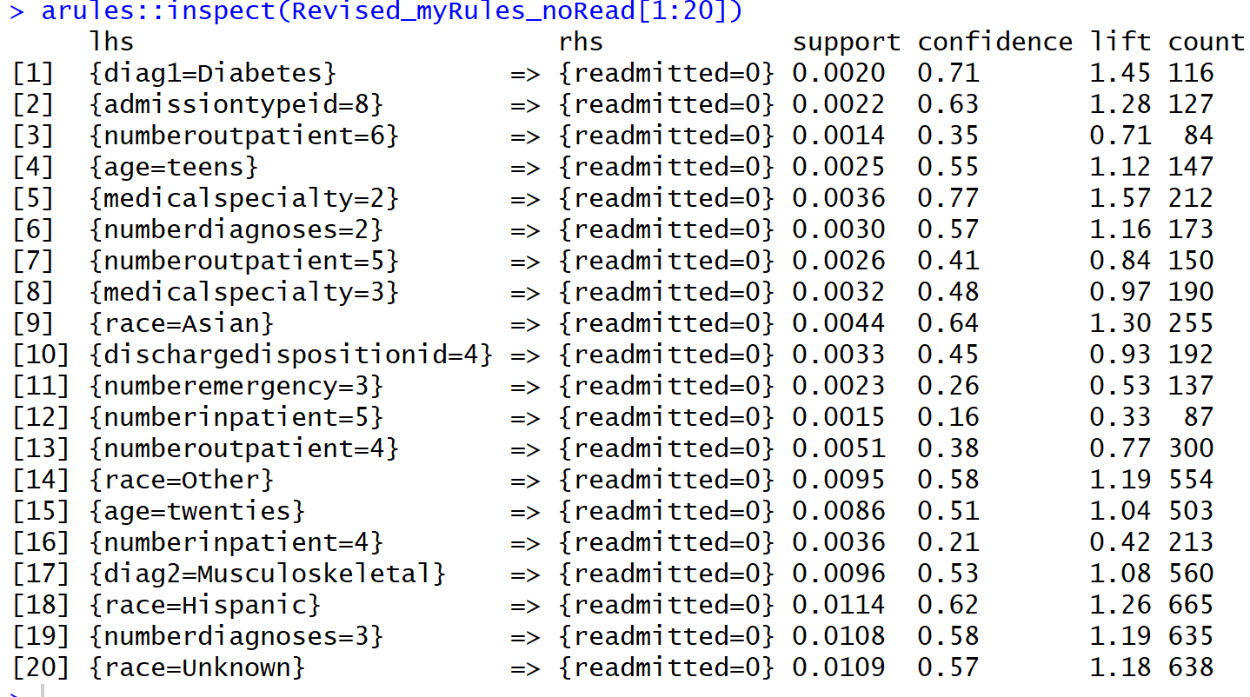
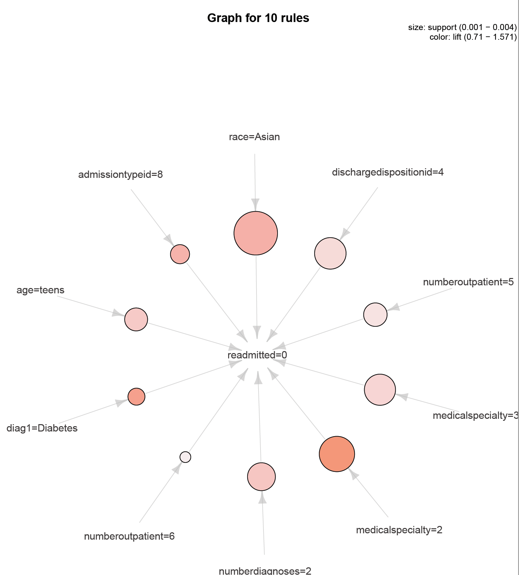
Methodology
The association rule mining shows associations for patients who are not getting readmitted.

Slide 23
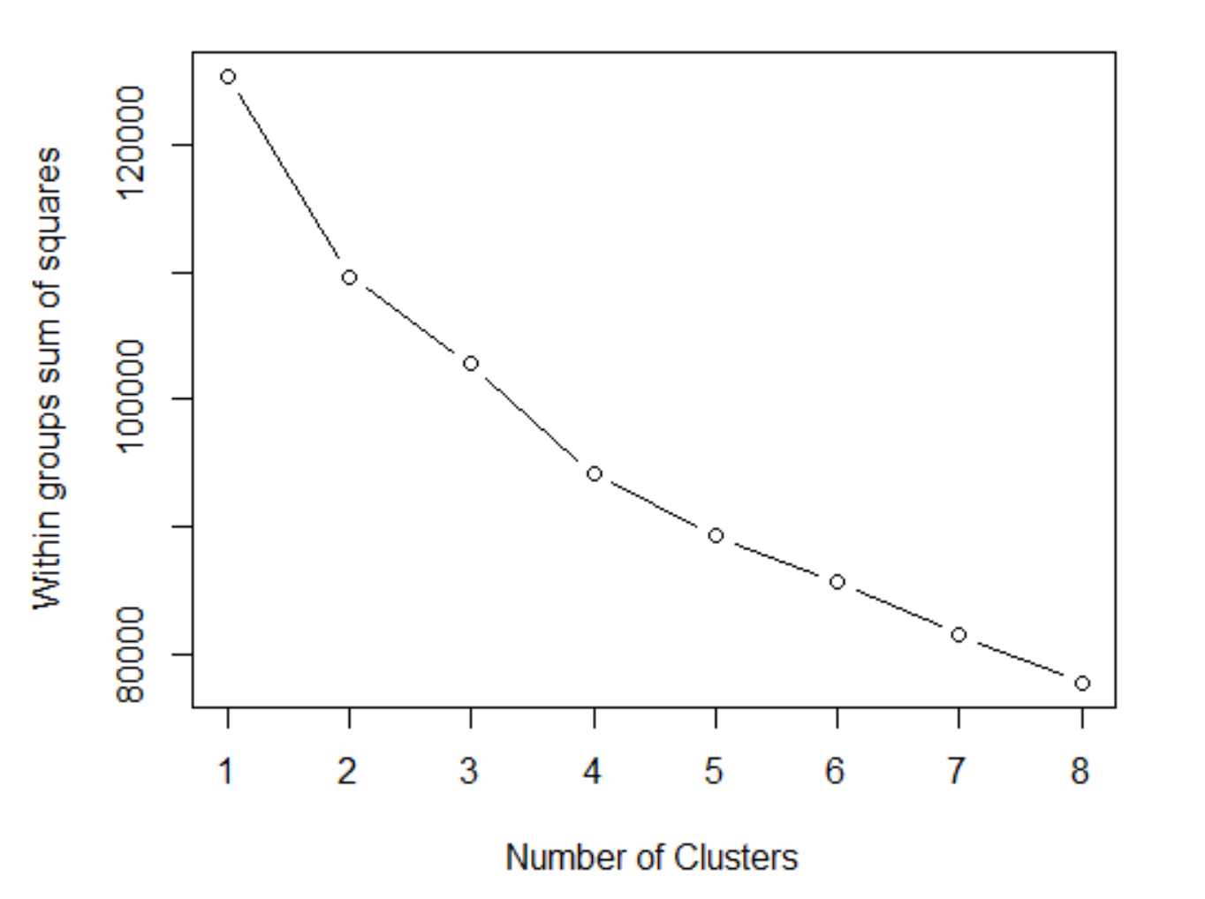
Methodology
Next technique that was applied was K-means clustering.

Slide 24
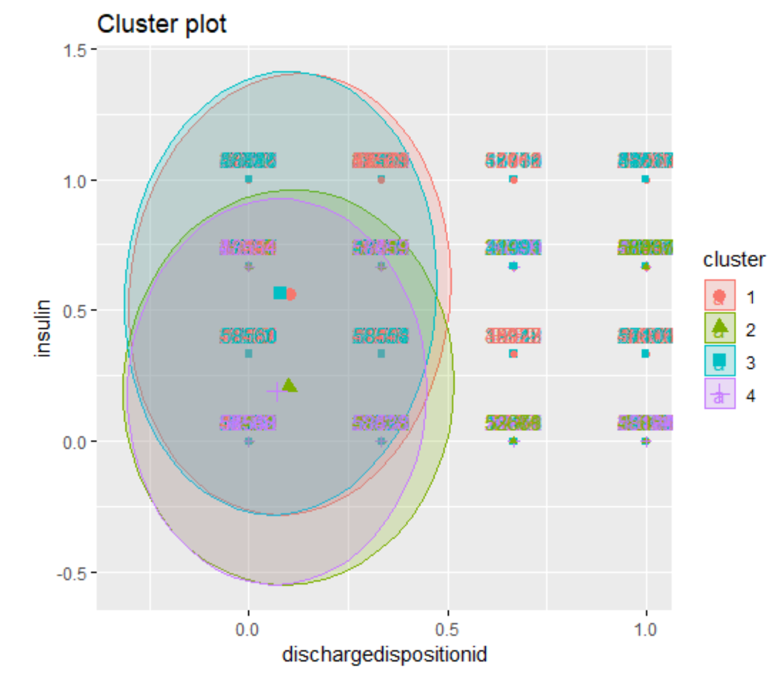
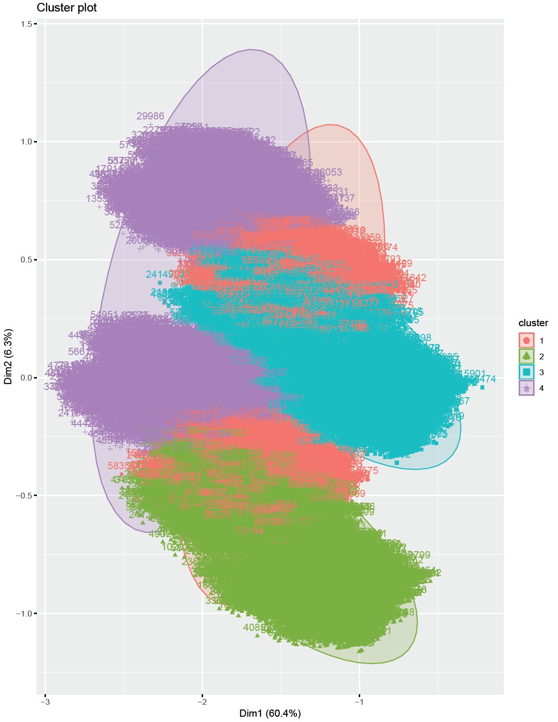
Methodology

Slide 25
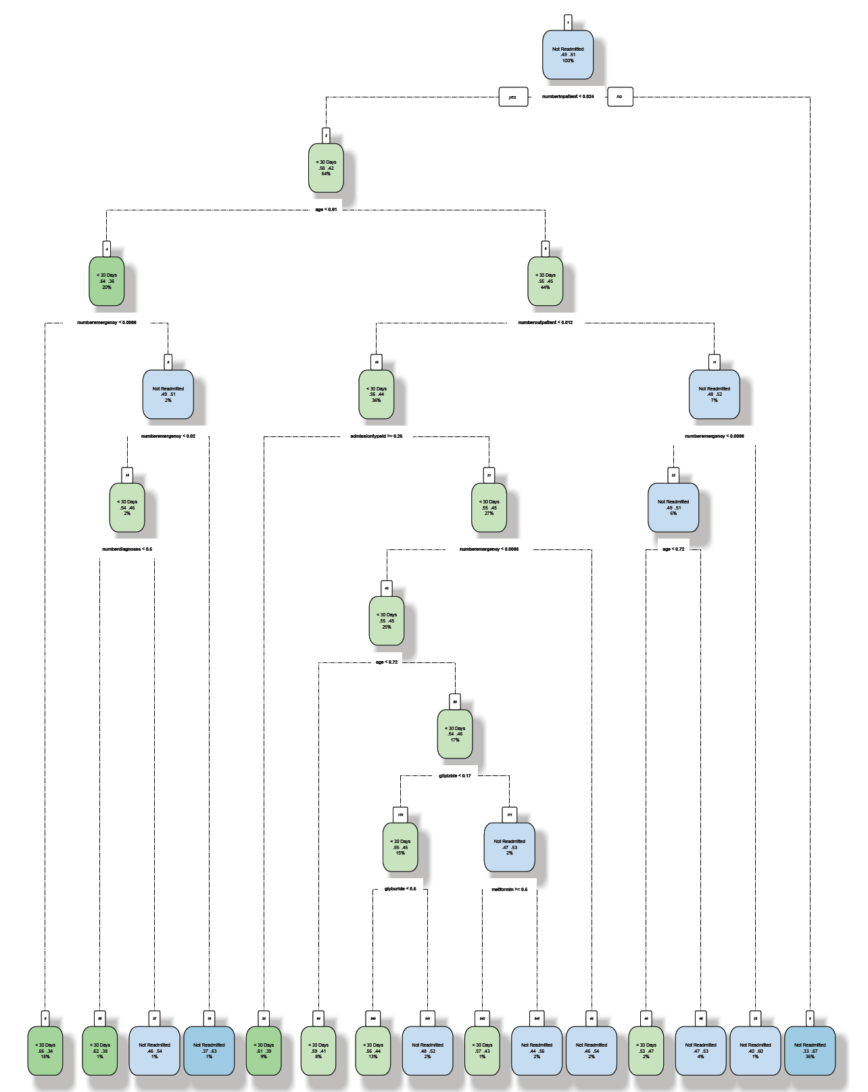
Methodology
Next technique applied was Decision Tree

Slide 26
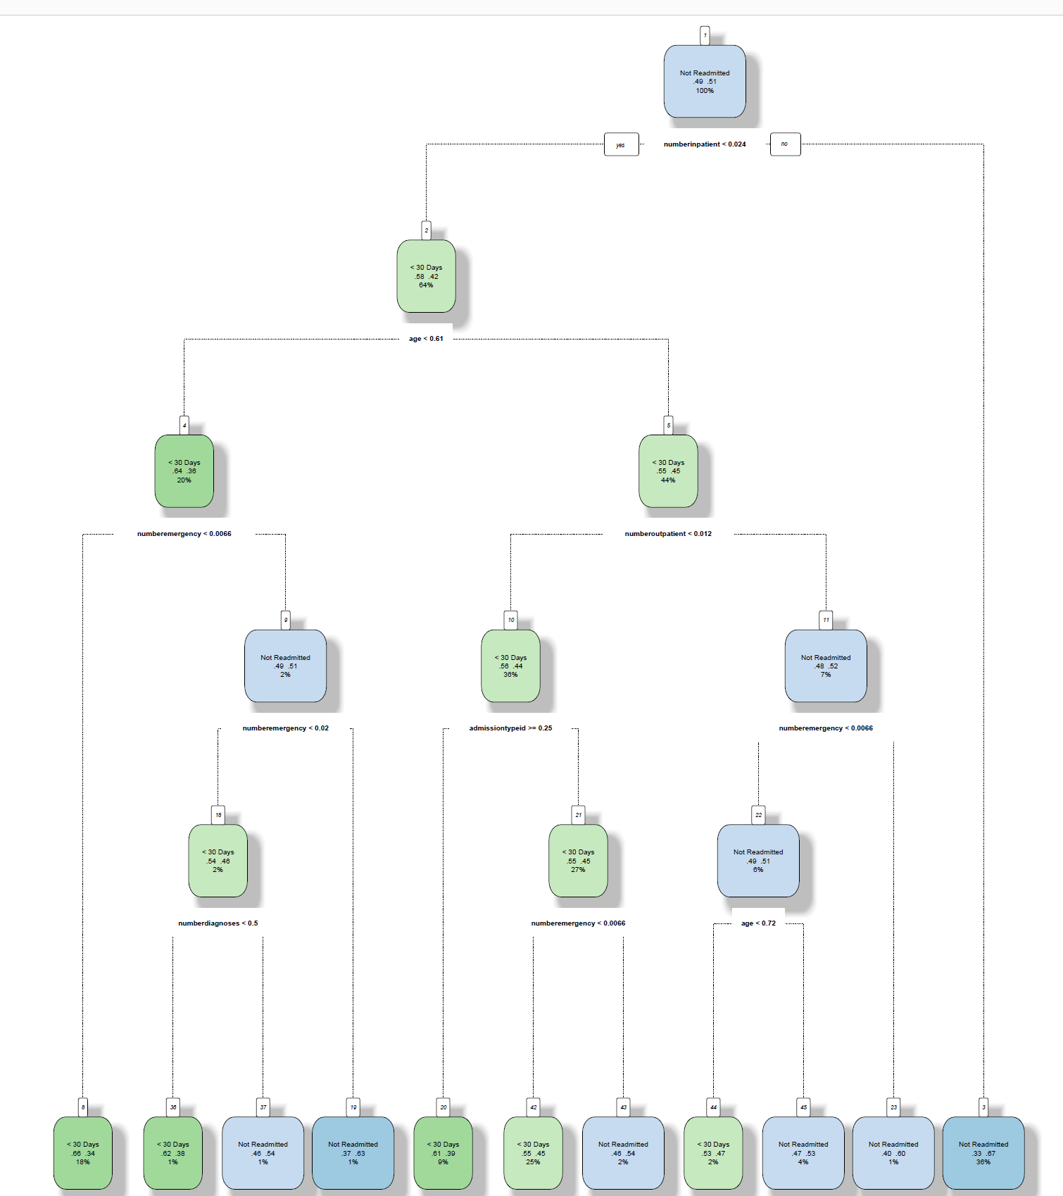
Methodology

Slide 27
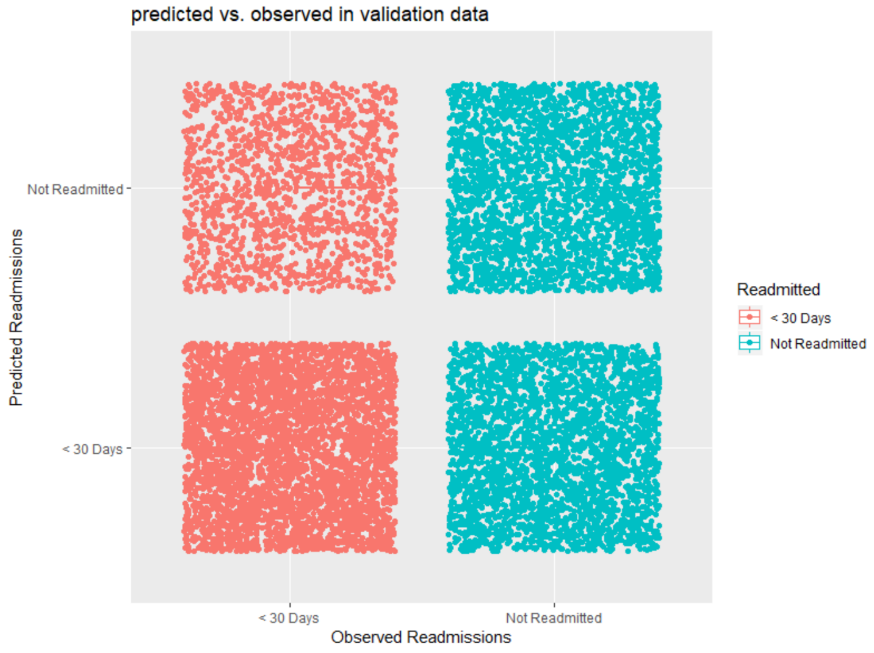
Methodology
The best accuracy with 58% accuracy was achieved with Naïve Bayes algorithm.

Slide 28
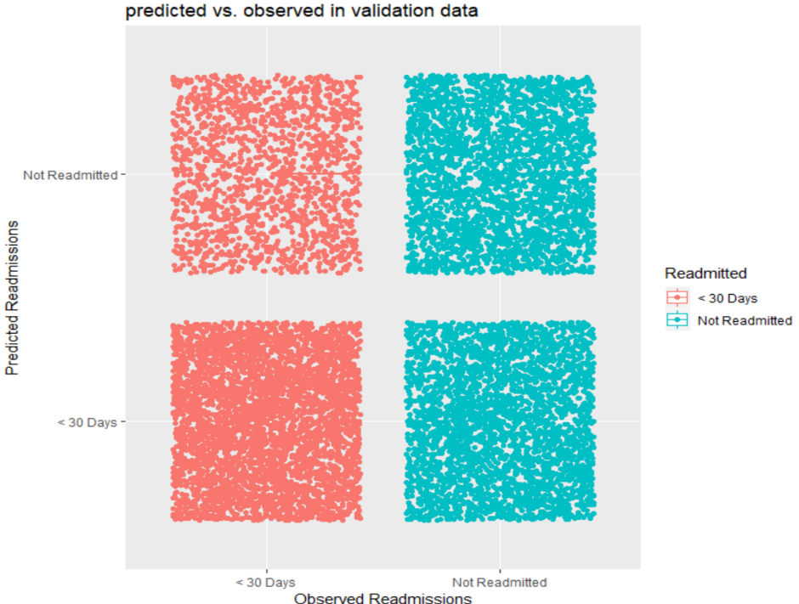
Methodology
With SVM classification, 60% accuracy was achieved. This performed better than the NB model.

Slide 29
Achievements
The project provided an opportunity to collect external data, converting it by cleaning, transforming and modeling with the objective of identifying useful information, suggesting collections and supporting decision making.
The result indicates the importance of using different data mining techniques to develop accurate prediction models.
Weighing the benefits of application of each machine learning models, can reduce the computation costs and provide the greatest precision.
Even though the data used in the project was highly sensitive, but it does not contain any personal details like name or phone number or home address, through which an individual can be identified. It mostly contains the different characteristics and hospital admission details of the individual.

Slide 30
IST 659 – Data Admin Concepts & Database Management
Online Pizza Database

Slide 31
Introduction
The objective of this project was to build a database for a pizza company for online ordering application.
Programming – SSMS, R Studio, Draw.io

Slide 32
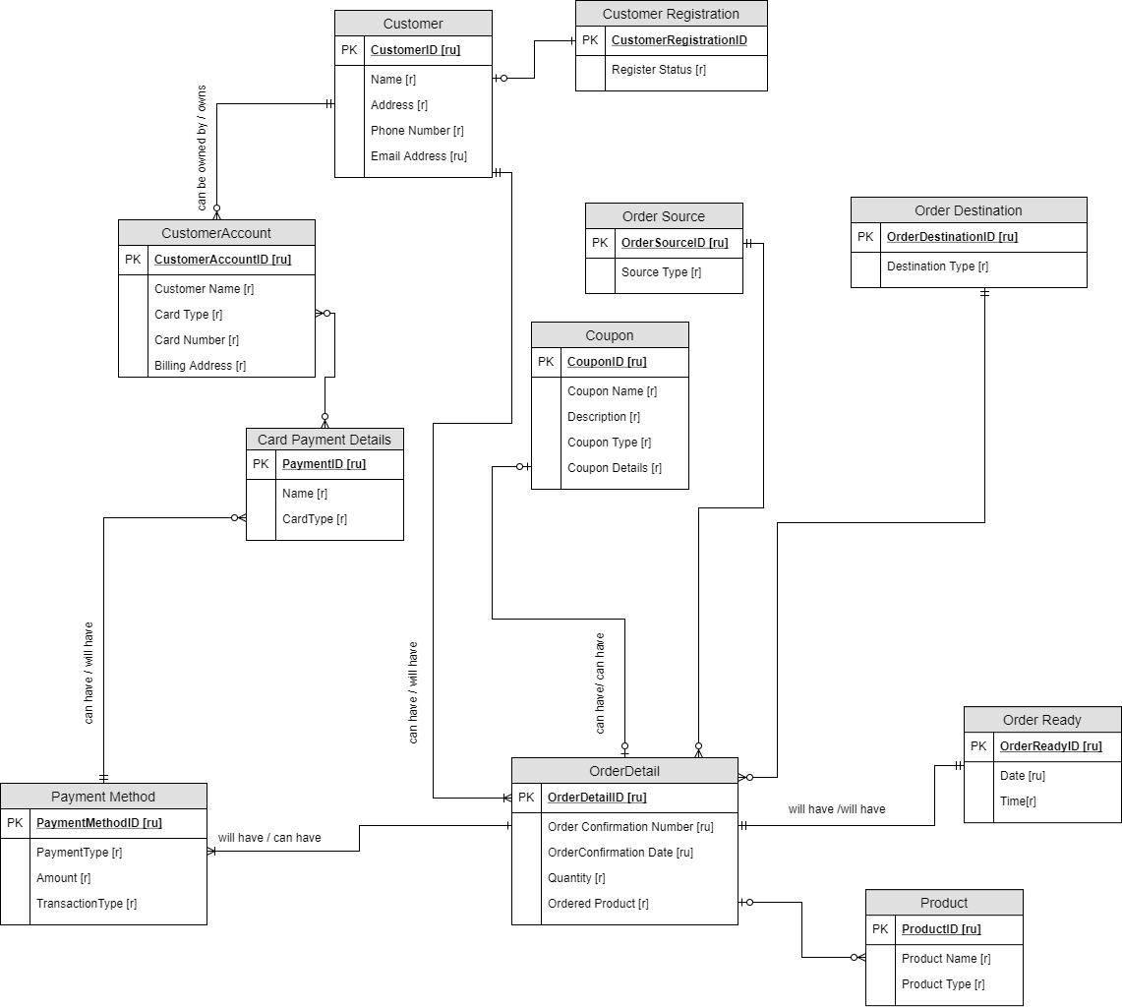
Conceptual Model

Slide 33
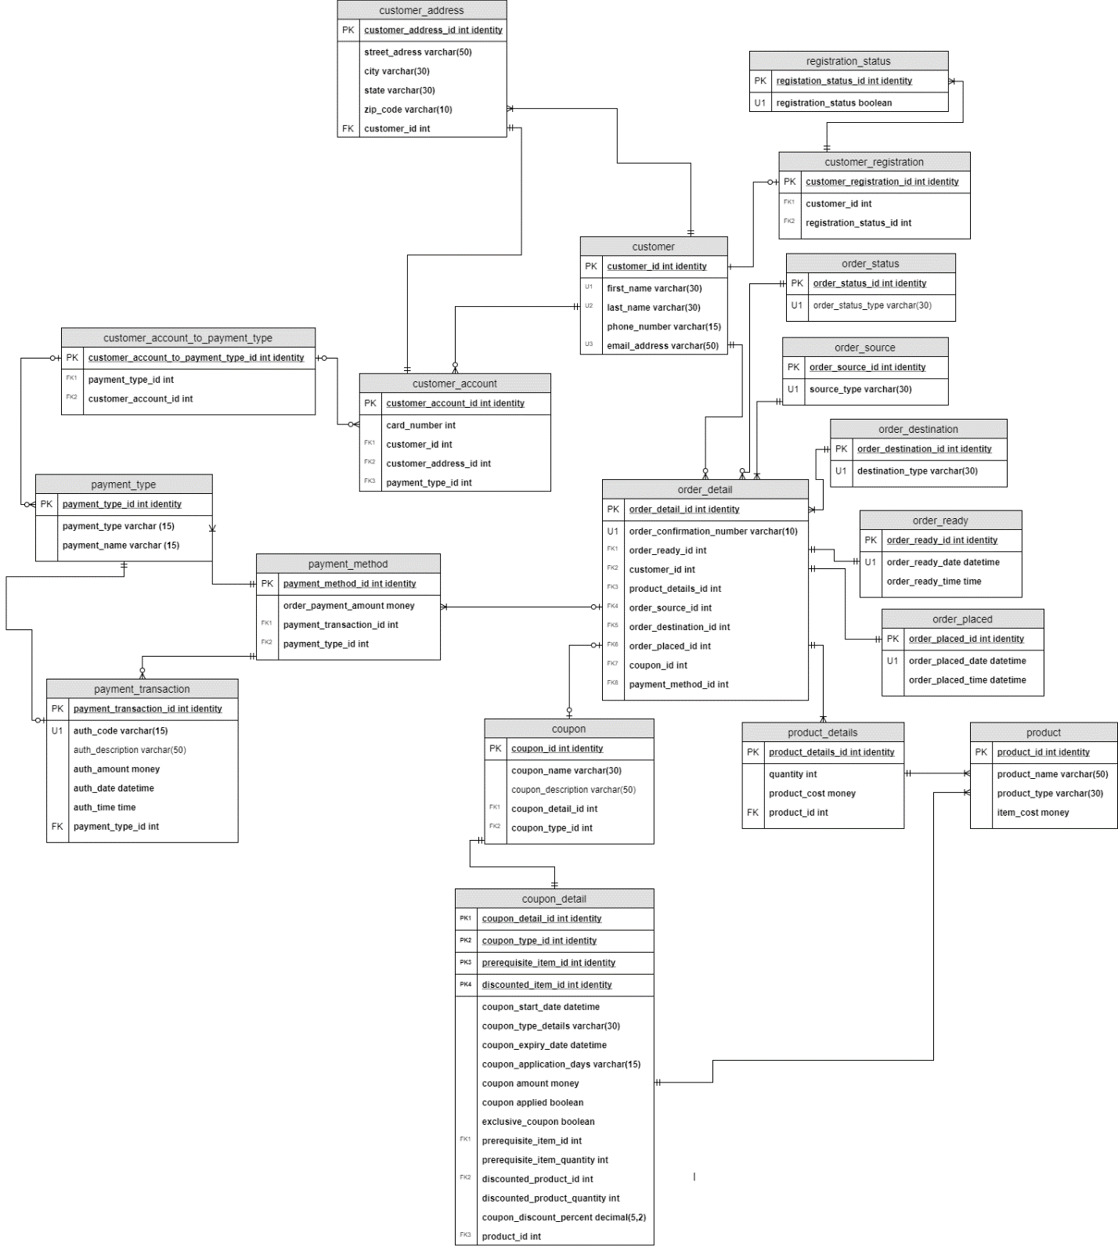
Normalized Logical Model

Slide 34
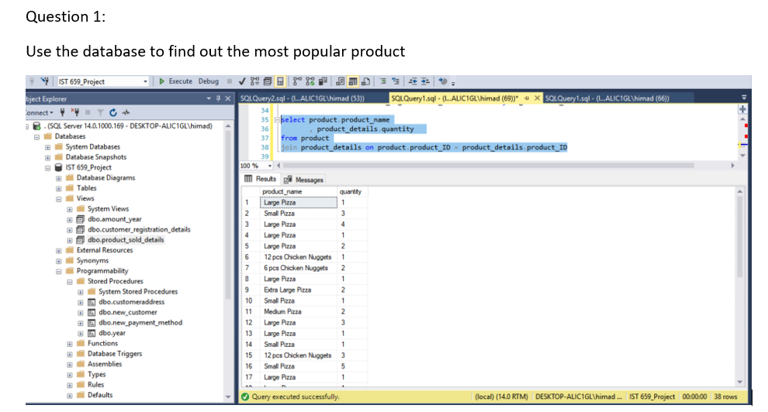
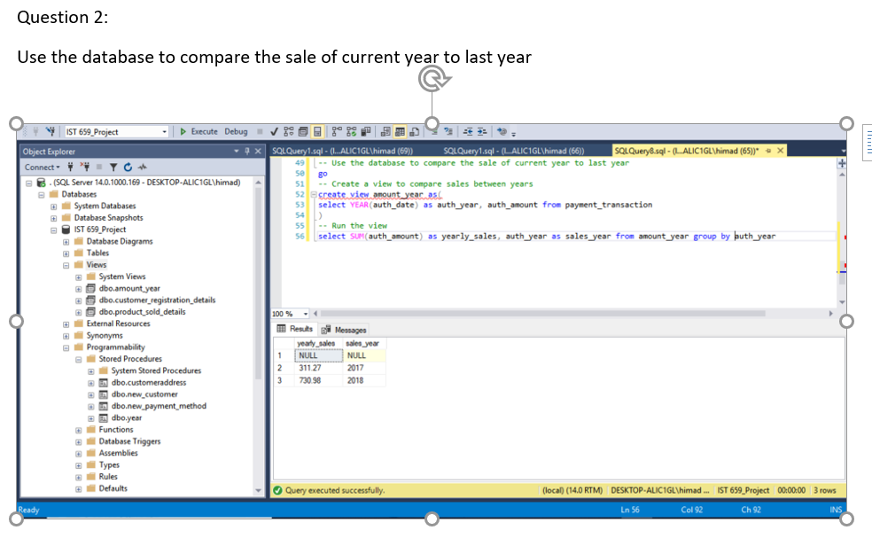
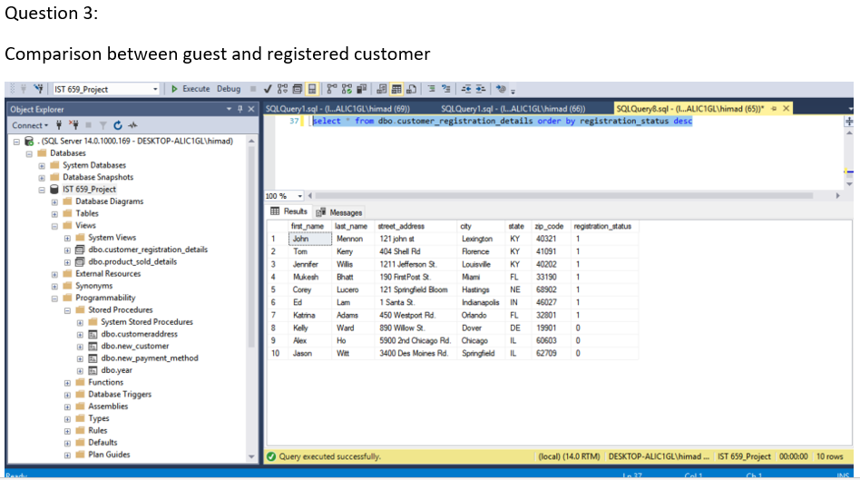
Problem Statements

Slide 35
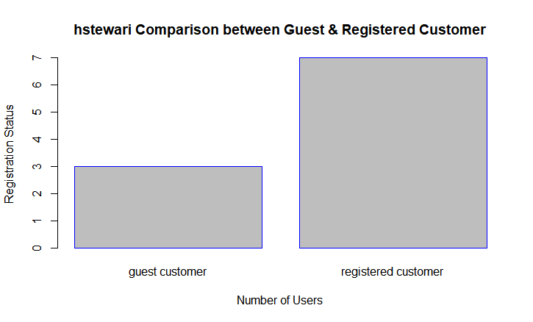
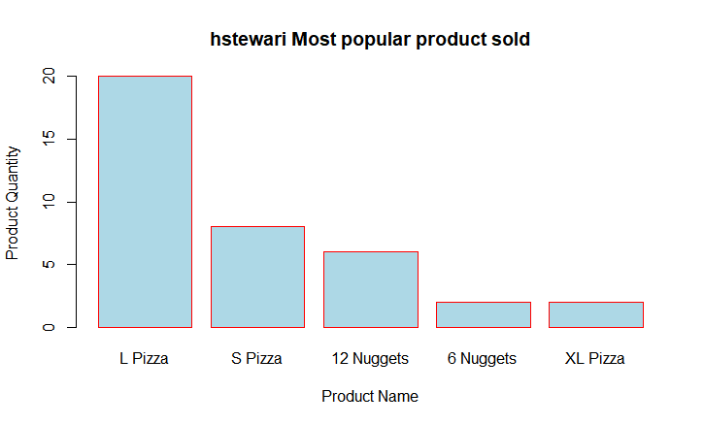
Bar Charts

Slide 36
Achievements
The project help to develop data management skills
The data management solution signifies how the data is stored, organized and can be accessed for data analysis and data science
The database was created using a very common concept of the pizza company and the data stored are not real-time data and are mostly test data used to create the database. It would not affect any pizza making company.

Slide 37
Overall Achievements
Each of the courses in the program gradually increase the level of complexity and improve the data science and analytical skill
In all the projects, the raw data was collected and converted and organized to find out the insights from the data and make conclusion
All the projects shows the proper use of data visualization to clearly communicate the insights from the data through charts and plots
Proper suggestions were made from the data analysis which would help in taking decisions
The analysis was communicated in simple language, so that every person who doesn’t have knowledge of data science can understand
While collecting data, the privacy of the data was taken care, so that it does not contain any personal details through which an individual can be identified.

Slide 38
Thank You

